Slide 1


Slide 2
Social Media and the
NYC Health Department
John LaDuca
Director of Online Editing
New York City Department of
Health and Mental Hygiene

Slide 3
Why Social Media?
Traditional outlets are shrinking
  2007: 13 health reporters
  2009: 0
Our audience is increasingly moving to Web 2.0
Demographics unreachable through traditional media, e.g. teens

Slide 4
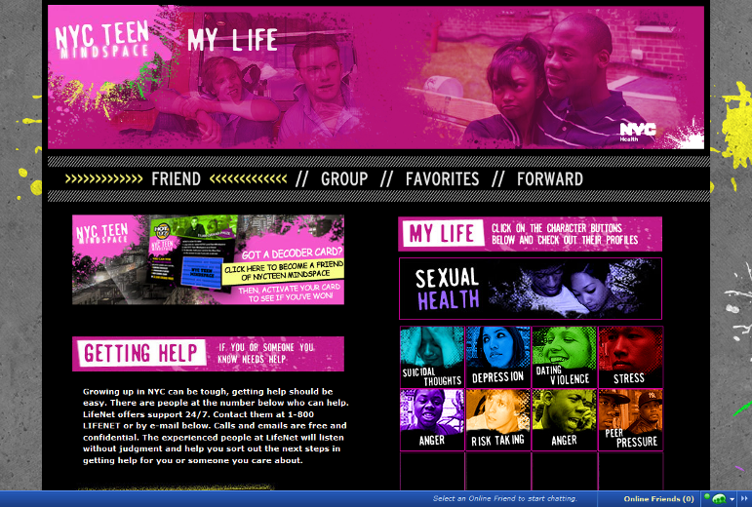
MySpace – NYC Teen Mindspace

Slide 5
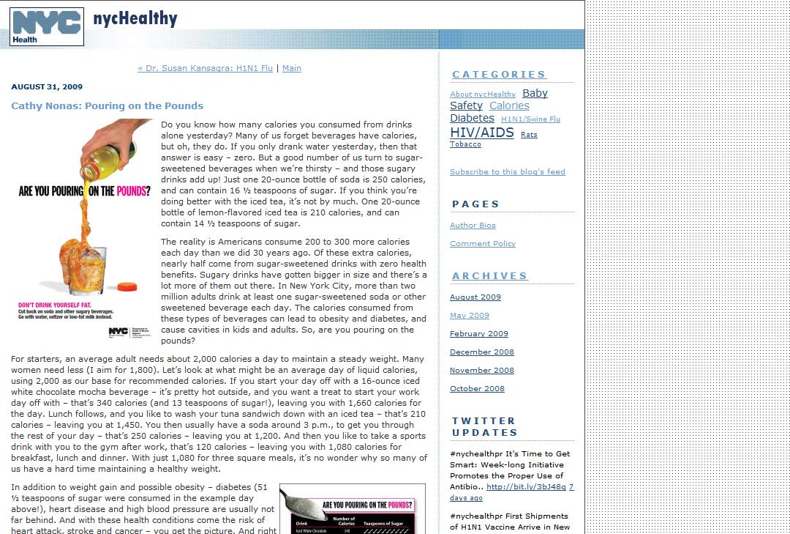
Blog - nycHealthy

Slide 6
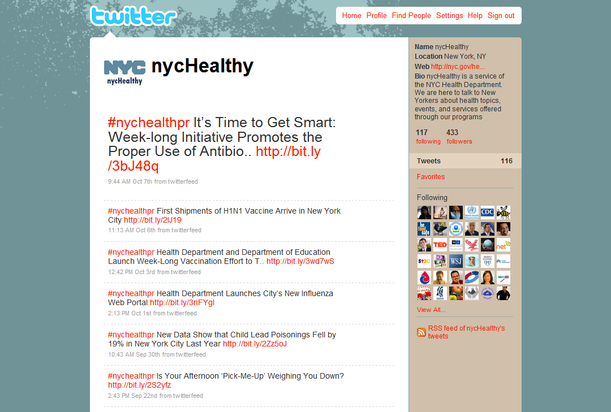
Twitter - nycHealthy

Slide 7
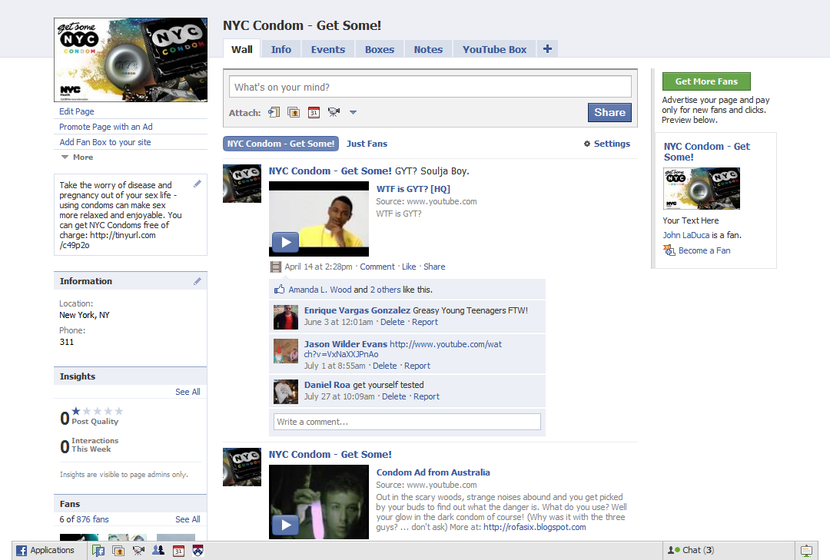
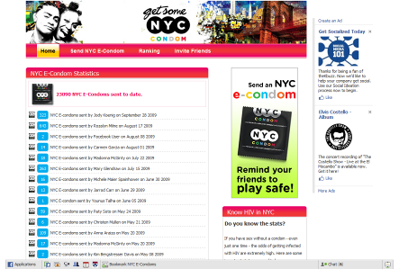
Facebook – NYC Condom

Slide 8
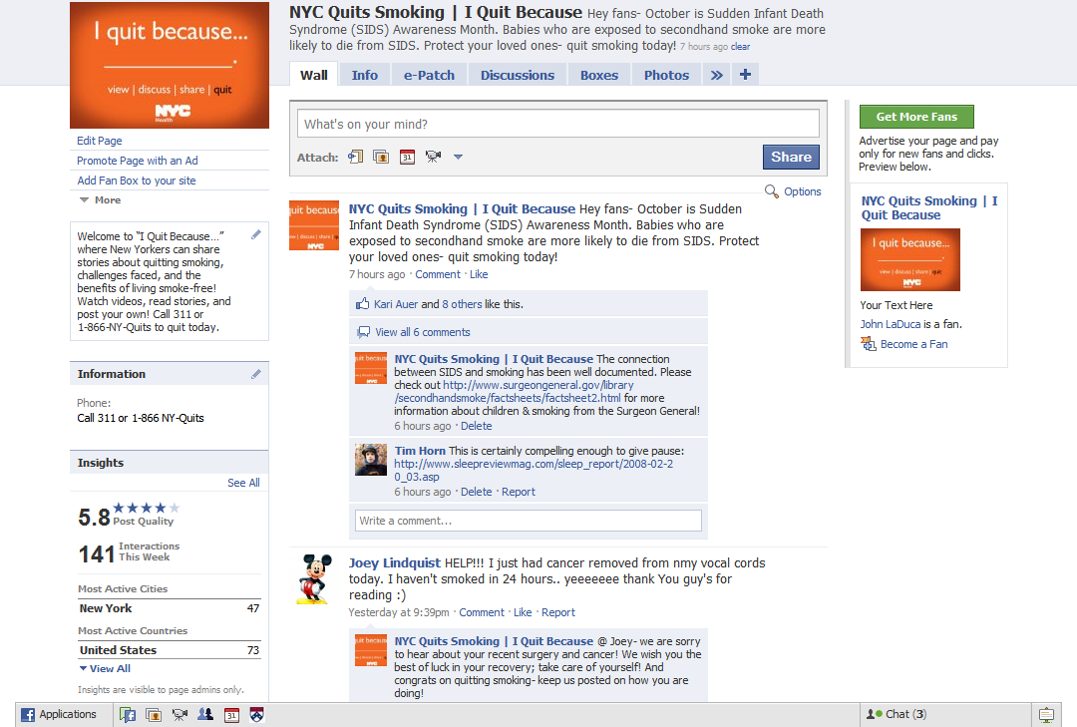
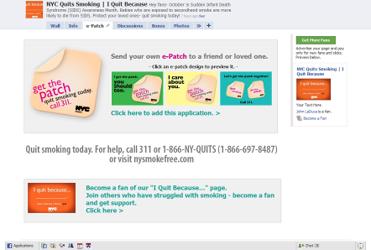
Facebook – NYC Quits Smoking

Slide 9
OEM Mission
Plan and prepare for emergencies
Coordinate emergency response and recovery efforts
Educate the public about preparedness
Collect and disseminate critical information
Seek funding to support preparedness

Slide 10
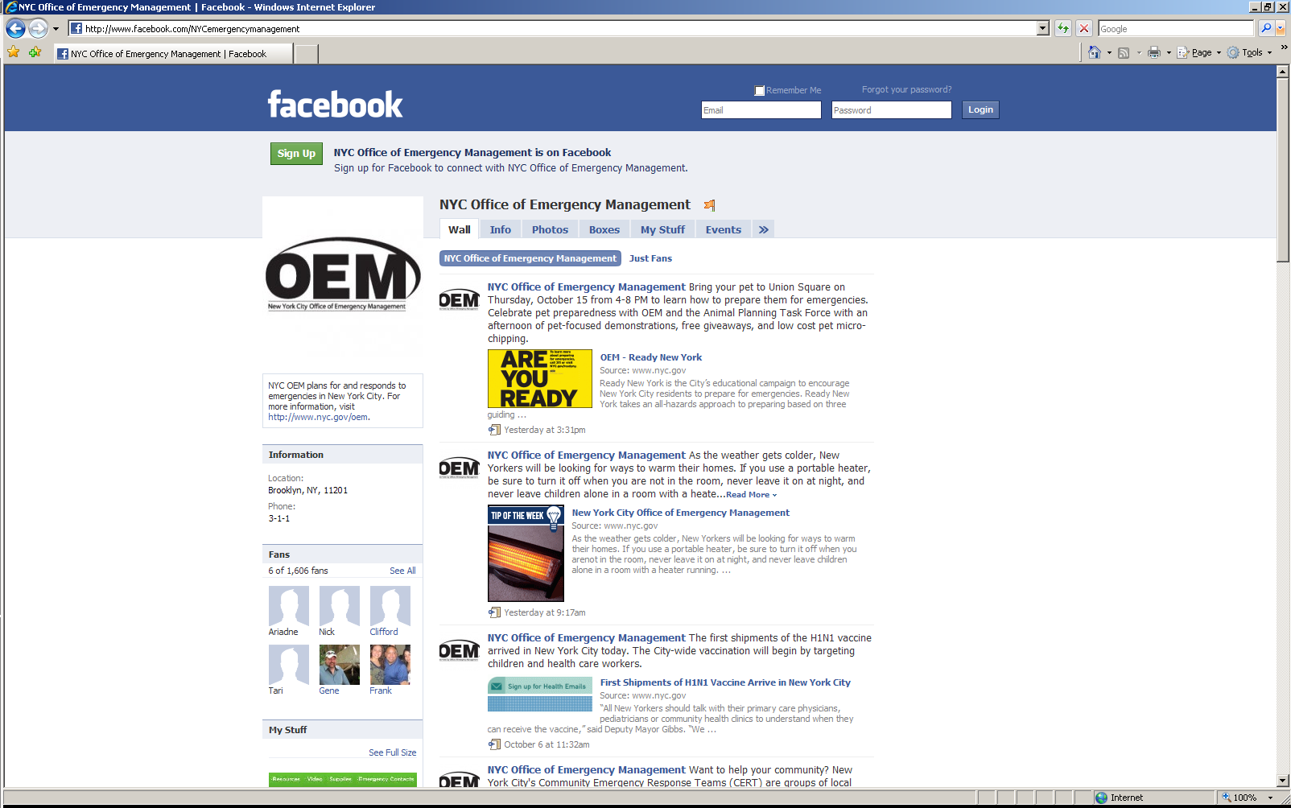

Slide 11
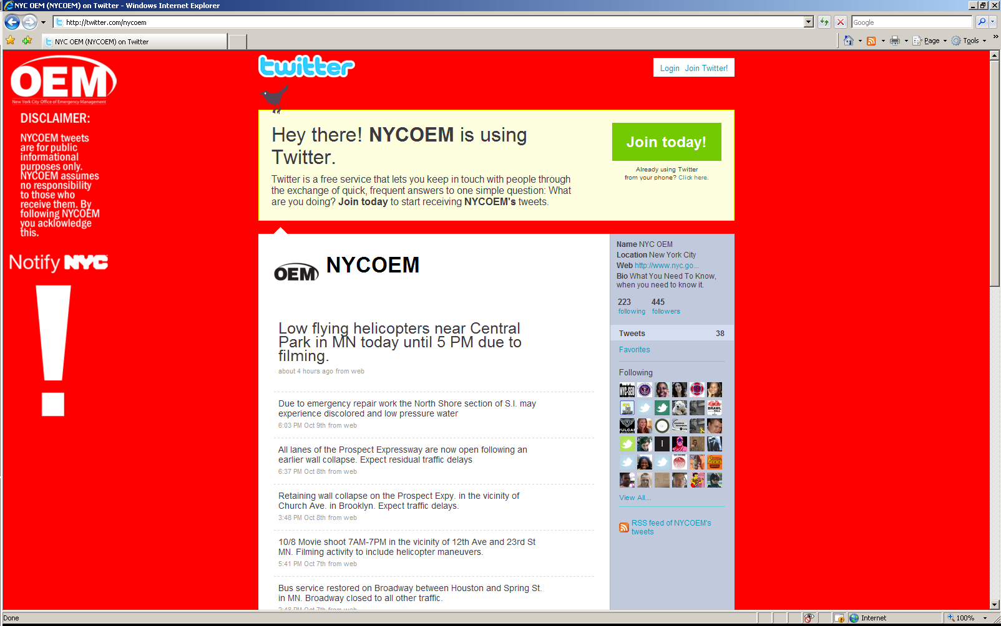

Slide 12
NYC 311’s Online Communications Program
Dan Starobin
Interactive Communication Project Manager
NYC 311

Slide 13
Twitter
311 began using Twitter in keeping with Mayor Bloomberg’s vision of continuing to improve government access.
At its core, Twitter is a free advertising/ marketing/ promotion tool.
Notes:
First tweet May 4th.
Many municipal, state and federal agencies have been using Twitter for the past couple of years.

Slide 14
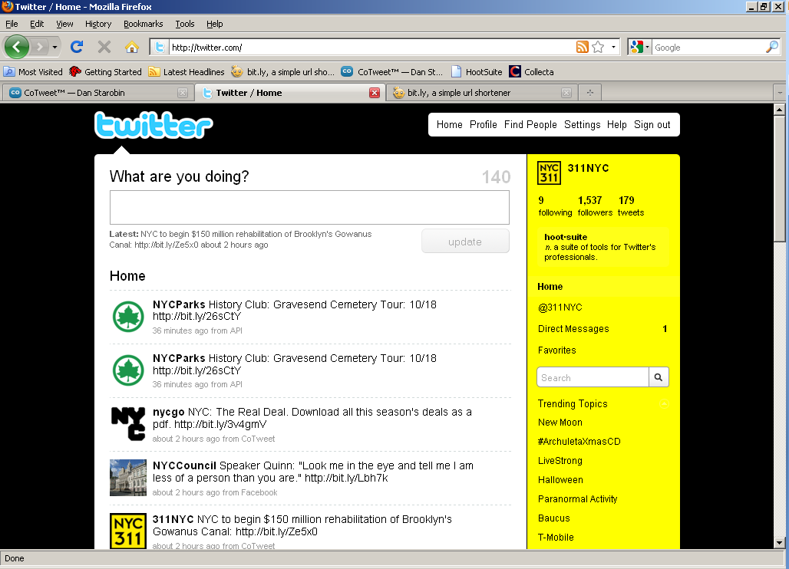
What do you want to tell people?
Notes:
Even at the individual level, when a user answers the question “What are you doing?”, they’re promoting themselves or a part of their daily lives (however mundane that might be).
CLICK
A more appropriate question here would be “What do you want to tell people?”
NEXT SLIDE

Slide 15
Twitter as a Promotion Tool
311 began using Twitter to promote 311 Online.
Notes:
Accordingly, Twitter was first used to promote 311 Online as part of a one-way, outbound communications strategy.
NEXT SLIDE

Slide 16
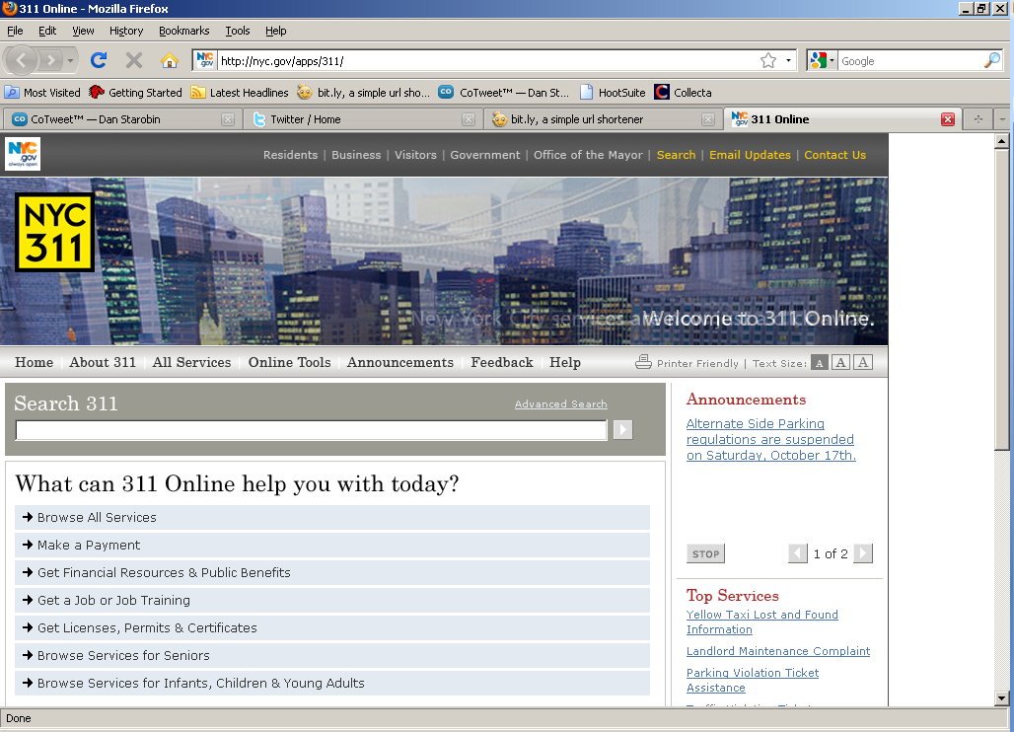
throw out large item
Notes:
311 Online is a website that provides all the information and many of the same services that the call center provides.
Let’s say you want to know how to dispose of a large item.
CLICK
NEXT SLIDE

Slide 17
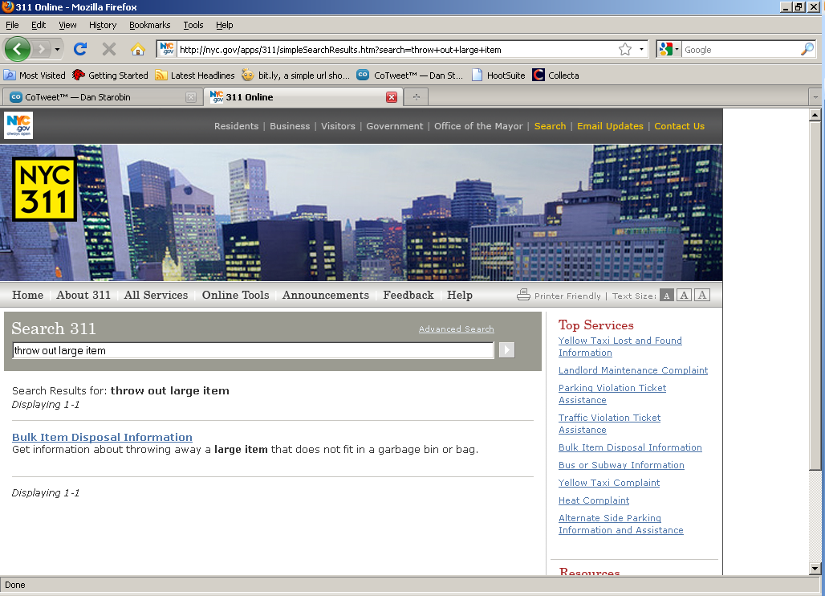

Slide 18
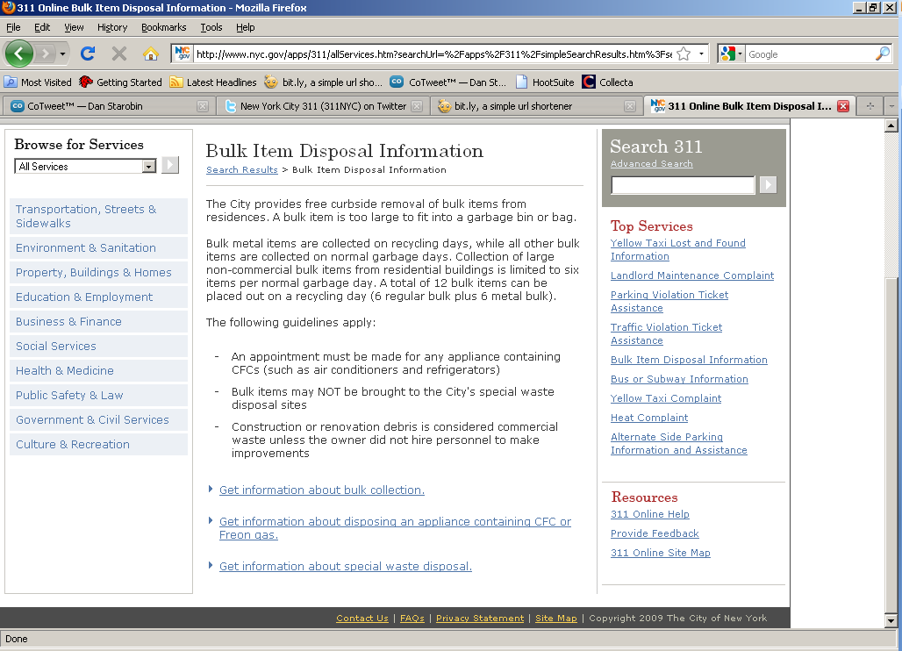
Notes:
In this case, selecting one of the links beneath the description of the service routes the user to Department of Sanitation webpage.
We want to direct our Twitter followers to this page because we know this is a popular service based on call volumes and views of this specific webpage.

Slide 19
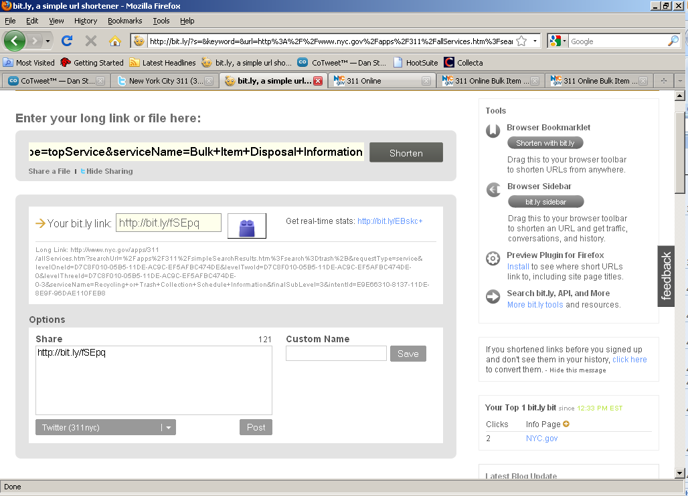
Notes:
Paste the link into bit.ly, which is a free URL shortening service.

Slide 20
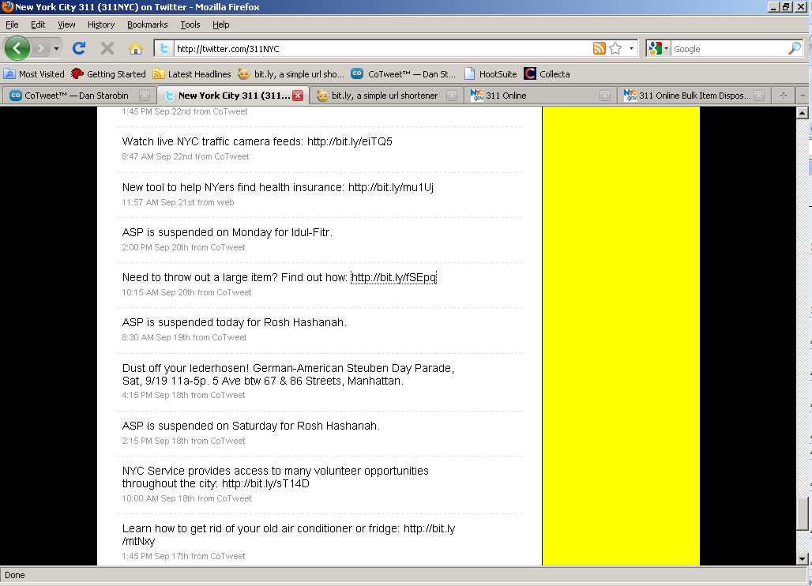
Notes:
Beyond the convenience of being able to work with a shorter link, one of the most useful bit.ly features lies in its ability to track the number of times one of its links is clicked on.
This can help gauge interest in a particular topic.
NEXT SLIDE

Slide 21
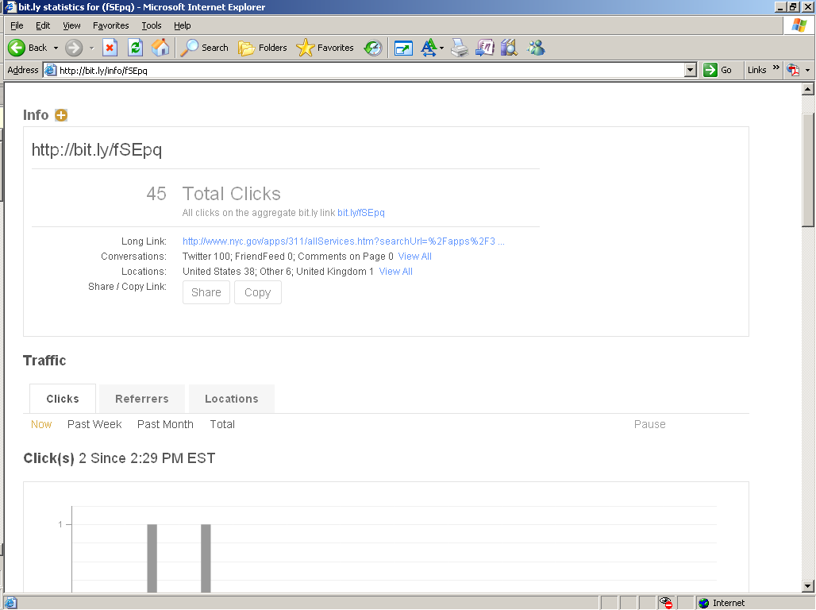

Slide 22
Two-way Communications
Our followers began to ask us questions.
  Ramifications of answering?
    Would we be flooded with more inquiries?
    How would our workload increase?
    What boundaries should be set for our responses?
    What kind of expectations would we be setting?
Notes:
When our followers began to ask us questions, we initially did nothing. Although we could answer them, we weren’t sure what the ramifications of responding directly would be.
CLICK
Brought to light the fact that however simple Twitter might seem, a good deal of consideration must be put into answering these questions.

Slide 23
Two-way Communications
Indirect responses
  We were called out on this tactic by a couple of users.
    Illustrates the point that there is an informal set of standards associated with any communication channel.
Notes:
We responded to the first few inquiries indirectly.
Our Twitter followers expect 311 to interact with them individually, since our core competency and mission is to provide strong customer service.
CLICK, read slide, then below:
Operating outside these norms can garner negative attention, which can be magnified rapidly depending on the channel used.
In the case of Twitter, all it takes is a single negative comment made by one or two popular users to spark a torrent of negative attention.
Conversely, one well-timed response can diffuse a potentially damaging situation.
We haven’t yet experienced this situation, but it’s important to realize that it can happen.

Slide 24
First Contact
First direct response to a follower was on Sept 29th.
Only respond if the inquiry can be answered through a referral to a website or 311 Online.
Notes:
We’ve only received a handful of inquiries since then, but expect the number to increase as more people follow us.
CLICK
To answer the previously mentioned question about boundaries, we’ve set a boundary whereby we limit responses to information that can be found on public City agency websites.
We aren’t directing the public to non-NYC.gov sites, except in cases in which an organization has partnered with a City agency.
This practice is analogous to the one our call takers follow in that they will only provide information that exists in our database.

Slide 25
Twitter as a Listening Post
People are always talking about the City
By engaging with followers, we encourage more interaction/ discussion
Notes:
We’re providing a hub around which discussions and commentary about the City can revolve. This gives us a window into public sentiment.

Slide 26
Tweet Topics
Alternate Side Parking regulations
Retweet OEM alert tweets
Events
Citywide initiatives and programs
Most frequently used 311 Online services
Notes:
AFTER slide, discuss this:
Events, like the recent Citywide Bocce competition or Columbus Day Parade.
Citywide initiatives like the rehabilitation of Brooklyn’s Gowanus Canal or the Dept of Finance’s Penalty Relief Program.
Most frequently used 311 Online services, like how to find an item lost in a cab or how to get rid of a gallon of old turpentine.
We’re in a position to know what the public is interested in because we’re constantly extracting information about the most popular services from our call center and 311 Online.

Slide 27
Account Management
Account is managed using a web-based thin client called CoTweet.
  Allows tweets to be scheduled and simplifies workflow management.
Notes:
Multiple people can manage a single (or multiple) Twitter accounts without confusion.
Allows assignment of responses to different individuals.

Slide 28
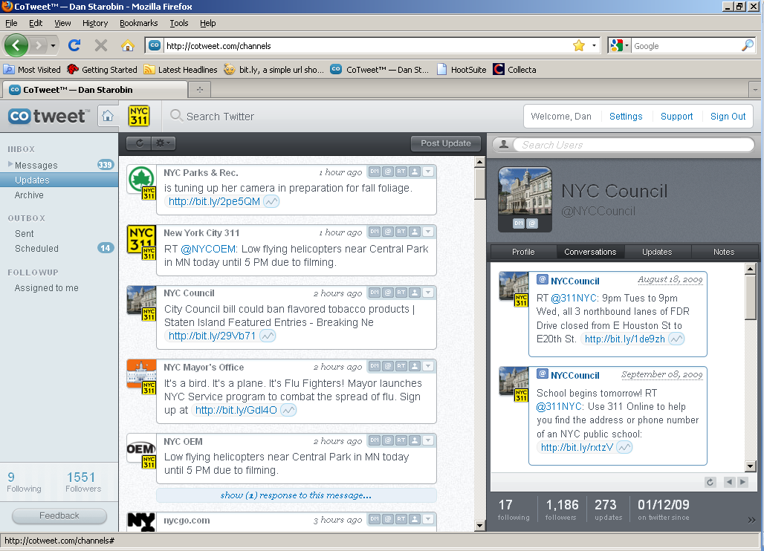

Slide 29
The Bigger Picture
Twitter is best used a part of a broader online communications program.
  Can work well in concert with a website, blog and forum.
Service requests
What about Facebook?
Notes:
Ideas include creating a blog to develop 311’s personality online and a forum that would allow the public to comment about specific services and their overall experiences in dealing with the City. A forum could provide us with an even deeper, more candid view of public sentiment as people have conversations about us on our turf.
We’ve translated the information sharing portion of our call center experience to Twitter. Although we’re not advertising it, we’re also prepared to accept service requests through Twitter. We’re not sure what type of requests to expect and what format the request related information will come in, but we’re approaching it as a learning experience.

Slide 30
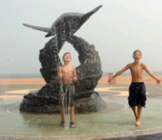

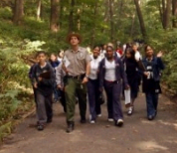


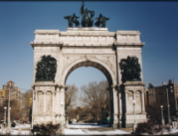


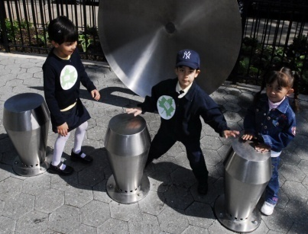


New York City Department of Parks & Recreation
Social Networking Strategies
Tom Hughes, Director of New Media
New York City Technology Forum: Social Networking in Government, October 15, 2009
Michael R. Bloomberg, Mayor
Patricia E. Harris, First Deputy Mayor
Adrian Benepe, Commissioner of Parks & Recreation

Slide 31
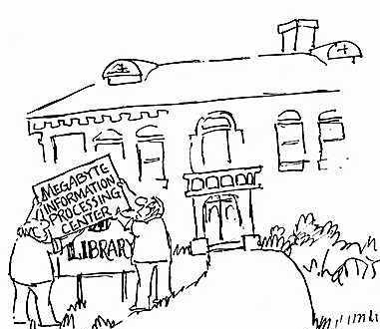
Notes:
As IT professionals, we are all used to dealing with changing technology. But since popular adoption of the internet, the rate of change has increased and IT-related developments are affecting nearly every aspect of how organizations operate. More of our colleagues in departments throughout our agencies need to adjust to this environment.
The rapid growth of social media tools is one example of this change; through them organizations are learning new ways to communicate directly to the public. I’d like to briefly review Parks initial use of social media in the context of one key decision that faces our organizations: now that these platforms exist which allow everyone in an organization the ability to communicate messages to the public, how do we best structure the use of these social networks?

Slide 32




150 Million Active Users
4 Billion Photos
Source of 1 in 350 visits on the web
1 Billion views per day
Notes:
The popular social networking sites provide access to large communities online, and the ability to share media such as photos and video which can convey ideas in ways that words sometimes cannot. In structuring our social media accounts, we chose a strategy of establishing one account per service which would serve as our sole official presence on each target website. This served the short term goal of establishing a following on each site that could be built upon and cross-marketed amongst the sites. We targeted four sites to build our social networking base.

Slide 33
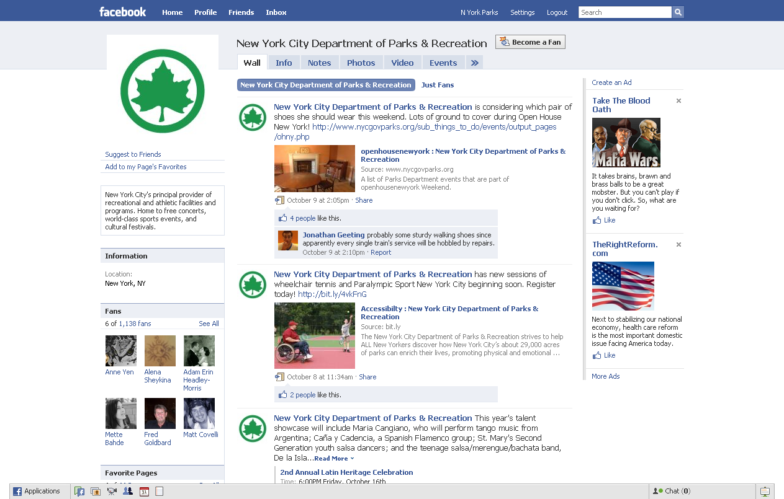
Notes:
We created a Facebook account to reach their extensive user base. The nature of the site allows us to use a conversational and fun voice in keeping with the Parks image. We post a status update every day and monitor responses.

Slide 34
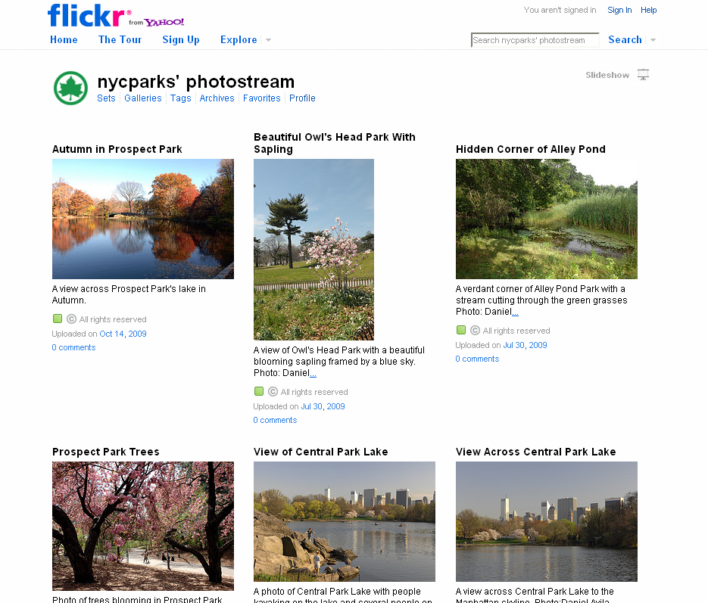
Notes:
Utilizing Flickr has given us an opportunity to share the beautiful sights of NYC’s parks in photos taken by Parks’ in-house photographers. We often upload photos timed to events such as change of season, but sometimes it’s just because we’ve seen something particularly eye-catching.

Slide 35
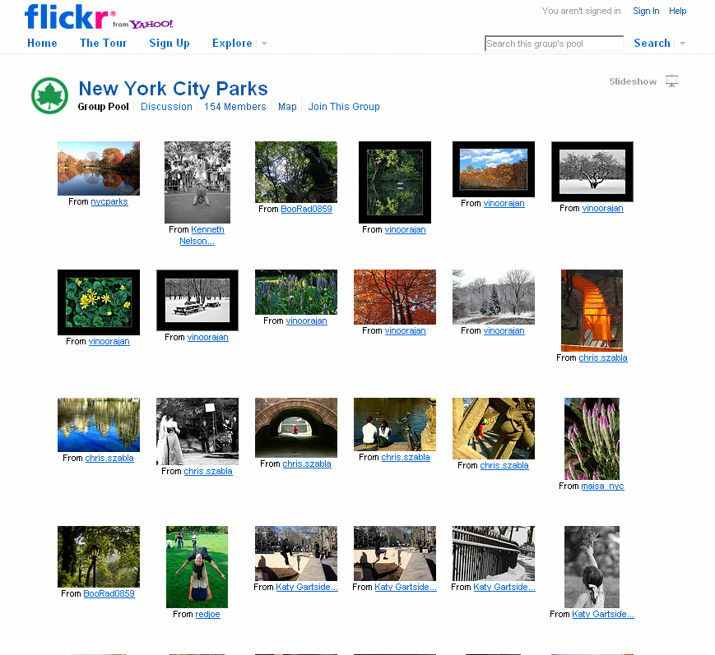
Notes:
We also created a New York City Parks “group pool”, which allows users to post their own often-stunning images of Parks. We are setting up a feature on our website to highlight one photo each month as a way of recognizing the public photographers’ efforts.

Slide 36
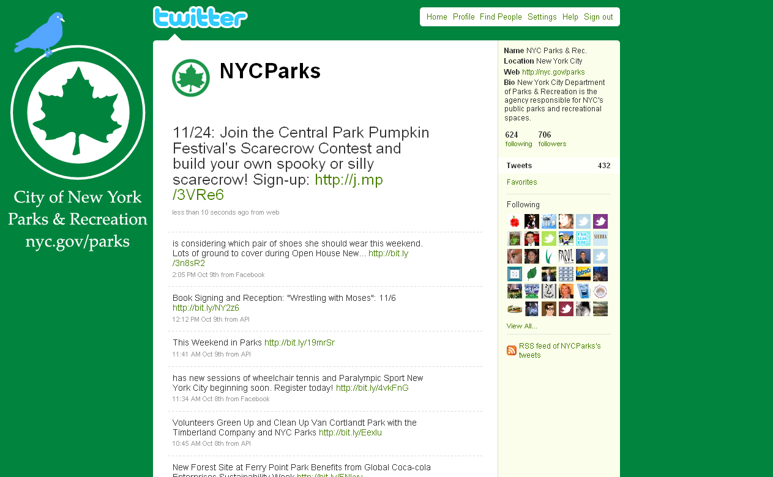
Notes:
Twitter has been a great outlet for posting links to our events, newsletters, and press releases. The real-time nature allows us to send dozens of messages each day, and we have automated much of the process through Twitter’s public API.

Slide 37

Notes:
As you can see, throughout our accounts, we’ve heavily branded our logo. We want users to know that these are official messages from the agency. In fact, these messages come from the Press Office, the official gatekeepers of Parks information, with assistance from the New Media Division. In organizing the initial Parks social media accounts, we reached out to divisions throughout the agency to ensure that they knew these channels were available for messaging, and that they should pass their messages through the Press Office, who would pass them on to us for publishing. Recently, we’ve received several requests from larger divisions within Parks to set up dedicated accounts, utilizing their individual branding, to communicate to their targeted audiences.
New York City Department of Parks & Recreation is known as a world-wide leader in the Parks and Recreation space, but as a large agency, there are divisions within Parks that have also made their mark in more specific areas.

Slide 38

Notes:
The Parks Opportunity Program, for example is the largest public transitional employment program in the country.

Slide 39
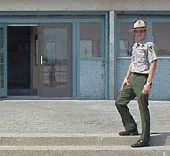

Notes:
The Urban Park Rangers, who can be found at Ranger Stations and Nature Centers throughout our Parks, have built a recognizable brand with their distinctive uniform and extensive offering of tours and programs, and publications.

Slide 40




Notes:
These are just 2 of many groups within Parks that have established a dedicated niche which they could target through social networking, whether through Parks’ main accounts, or by the creation of individual accounts operated by the division under the oversight of the Press Office and with the assistance of the New Media Division.

Slide 41
Division Accounts
Pros
Cons
Expanded, targeted messages directed to niche groups
Additional attention to these divisions and efforts
User confusion – is this really from Parks?
Harder to strategize communications
Manpower of oversight and facilitation, and “fan-building”
Notes:
This second strategy - setting up and maintaining additional accounts in addition to the Parks “parent” account - has costs and benefits need to weighed. Accounts for our larger divisions would allow them to push targeted messages to the segments of the community that they serve. Parks Opportunity Program, for example could attract a following of businesses in need of workers and update them with news to keep POP on their radar. With this targeted, niche audience, these divisions would be able to publish more frequent and detailed messages that wouldn’t have the same impact targeting a wide audience. On the downside, multiple accounts can cause user confusion. How is this group related to the Parks Department is one question users may ask, but question we really wouldn’t want to hear is – “Is this the official Parks account?”
Multiple accounts also create the need to spend much more time ensuring that overall messaging follows a unified strategy. How do the sub-accounts reflect the brand and voice of the Parks Department? Could some of the messages conveyed by the division be combined with other information to send a larger Parks Department message?
Finally, the maintenance and oversight of each account as well as the process of building up a fan base requires time and effort that needs to be duplicated for each new sub-account.

Slide 42





Event/Initiative Accounts
Notes:
A third strategy involves creating short-term accounts for large initiatives or events. If the event or initiative is ongoing or annual, the account can lay dormant, not consuming many work-hours until preparations for the next activity begin. As a producer of a variety of world-class annual festivals and events which draw millions of visitors each year, this is a strategy we also considered.

Slide 43
Event/Initiative Accounts
Pros
Cons
Expanded, targeted messages directed to niche groups
For annual events, building a year-to-year fan-base.
User confusion – is this really from Parks?
Manpower of oversight and facilitation, and “fan-building”
Notes:
This strategy has an additional benefit of maintaining fanbases for the event or initiative over the dormant periods.

Slide 44
Current Social Media Workflow
Press Office
Individual Parks’
Divisions
New Media Division
Notes:
We are weighing these strategies and other rapidly developing methods of utilizing social networking and will be monitoring the usage of additional social networking websites to decide the best use of our energy. For now, we are continuing our initial strategy of utilizing one official Parks account per service, with Parks Press Office as gatekeeper of information.

Slide 45
Successful Tactics
Get buy-in and input from senior management
Press office and web team work hand-in-hand
Identify gatekeepers with clear roles and responsibilities
Encourage participation throughout the organization
Tom Hughes
Director of New Media
New York City Department of Parks & Recreation
(212) 360-8110
Tom.Hughes@parks.nyc.gov
Notes:
No matter how you choose to structure your social media strategy, there are a few key tactics we can recommend based on our experience. Feel free to contact me if you’d like to discuss Parks’ experience with social networking in more detail.

Slide 46
Social Media Approach
Matt Dickman – Fleishman-Hillard for AT&T

Slide 47
LISTEN, PLAN, ENGAGE, ADAPT.

Slide 48
CONTENT IS KING.

Slide 49
DON’T BOIL THE OCEAN.

Slide 50
OPERATIONALIZE SOCIAL MEDIA.

Slide 51
